Slide 1
Quality and Cost
in the
True Performance Program
Capstone Project 2019 – Highmark Inc
Moe Wolf (MSHCPM ‘20)
Jonathan Dyer (MISM ‘19)
Jeremiah Humes (MSHCA ‘20)
Manjiri Kshirsagar (MSHCPM ‘20)
Faculty Advisor: Jim Jordan

Slide 2
Agenda
Objective
Framework for Evaluation
Solution
Recommendations

Slide 3



Objective
Which of the quality metrics are driving the cost outcomes?
What other quality metrics could potentially be added?
Investigate other value-based reimbursement programs.

Slide 4

Program Evaluation Framework
What is it?
Scientific method to study social interventions[1]
Evaluate the program for its effectiveness and efficiency
Systematic approach to improve or affirm success of a program
Why did we choose it?
Eliminate the issue of confirmation bias
Investigate areas where a program can be improved
Explore reasons for certain features not working

Slide 5
Program Evaluation Framework
Needs Assessment
Program Theory
Process Evaluation
Outcome Evaluation
Nature, magnitude and extent of the problem
Program conceptualization and design
Program operations, implementation, service delivery
Impact on targeted outcomes

Slide 6
Constraints and Limitations
Lack of comprehensive time series data
Time duration of evaluation
Provider level data for those who did not participate in program

Slide 7
Program Evaluation Framework
Needs Assessment
Program Theory
Process Evaluation
Outcome Evaluation
What is the problem that the program is trying to address?
What is the extent of the problem?
Who is the target population?

Slide 8
Needs Assessment
Problems addressed through this program
Overutilization of services due to the fee-for-service model
Misaligned incentives
Poor quality outcomes
Extent of Problem
<Add stats>
Target Population
Providers (Primary Care Physicians)
Patients

Slide 9
Needs Assessment
Problems addressed through this program
Overutilization of services due to the fee-for-service model
Misaligned incentives
Poor quality outcomes
Extent of Problem
<Add stats>
Target Population
Providers (Primary Care Physicians)
Patients

Slide 10
Program Evaluation Framework
Needs Assessment
Program Theory
Process Evaluation
Outcome Evaluation
Understanding the program and its components
Intended Effect of Program
Reviewing existing value-based reimbursement programs

Slide 11
Highmark – True Performance Program Overview
Reimbursement Opportunities
Reimbursement Type
Care Coordination
Lump Sum
Additional Incentives
Performance Measurement
Quality
Referral Management
Strong Medicare STARS ratings
Quality
Cost & Utilization
Indicators
Total Cost PMPM
ED Utilization
STARS Ratings
QA Score

Slide 12

Highmark True Performance Objectives
Supporting Primary Care Physicians (PCPs) in coordinating care, managing chronic illness, and providing preventive care.
Improve Experience of Care
Improving Health of Population
Reducing Per Capita Cost of Healthcare
Based on IHI’s (Institute of Healthcare Improvement)
“Triple Aim” of healthcare improvement

Slide 13
Quality Component - Stakeholders Perspective
Regulatory
Highmark Insurance
Primary Care Physicians
Patients
Aligns with Medicare Plan
STARS Ratings
Reduce increase healthcare costs
Incentivized to focus on prevention and wellness
Better health outcomes especially for chronic illness patients
Reduce preventable Emergency Department visits
Allows PCPs to improve their processes and implement best practices
Incentives aligned for payers and providers to improve patient experience
Reduce readmissions and inpatient stays

Slide 14
Quality Component Overview

Slide 15
Quality Component Logic Model

Slide 16
State of Value Based Reimbursement Programs

Slide 17
Program Evaluation Framework
Needs Assessment
Program Theory
Process Evaluation
Outcome Evaluation
Recipient Perspective of Program
Implementation Fidelity – Dose Delivered and Received

Slide 18
Process Evaluation
Are participants satisfied with the program? (Satisfaction)
“An unreasonable number of reasonable requirements”
How many providers/ persons are part of the program? (reach)
Providers in program: 548
Patients in program: 1.16 million
Extent to which the program was implemented consistently with underlying theory/ design/ philosophy. (fidelity of program)
source
improve healthcare quality outcomes for members - no data
reduce annual increases in total health care costs - only have data on 1 aggregated line/can we get more precise numbers?
help physicians engage in patient care coordination - unsure how TPP would improve this
help physicians engage in population health management - no data on health of population
Extent to which participants actively engage with program (dose received)
Perhaps too frequently in too cumbersome of a manner
“Had to employ an army of administrators to make this work”
Amount of each component delivered/ details about quality metrics? (dose delivered)
Some metrics seem to express co-linearity,
There are some “buckets” that don’t seem to have any metrics - outcome measures, health measures

Slide 19
Program Evaluation Framework
Needs Assessment
Program Theory
Process Evaluation
Outcome Evaluation
Recipient Perspective of Program
Implementation Fidelity – Dose Delivered and Received

Slide 20
Process Evaluation
Key performance indicators
PMPM cost
Define the counterfactual (outcomes in the absence of the program)
The counterfactual is what would have happened to the patients, the doctors, the cost and quality of care of those affected by the TPP had all else remained the same except the program not been implemented.
Cannot compare with counterfactual results—no data for non-TP providers
Additionally, no pre-/post- comparisons are possible—no data prior to 2018
One way to do this would be to randomize who gets to take part in TPP from those who opt in
What could be the potential confounders/ selection bias?
Opt-in
Implementation of other programs at the same time
Program effects (regression analysis results)
Difference in outcomes between regions
Which measures contribute most to the cost outcome?
Jake?

Slide 21
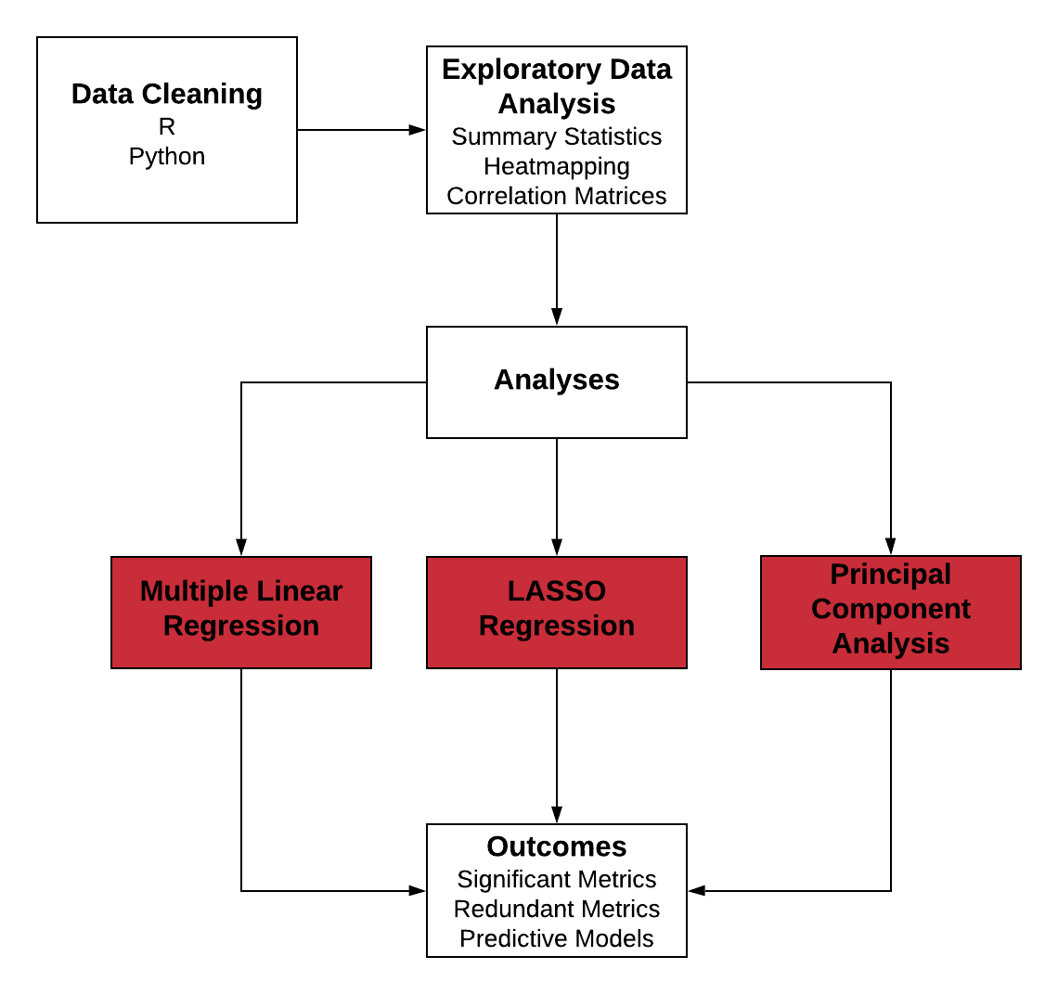
Quantitative Methods

Slide 22
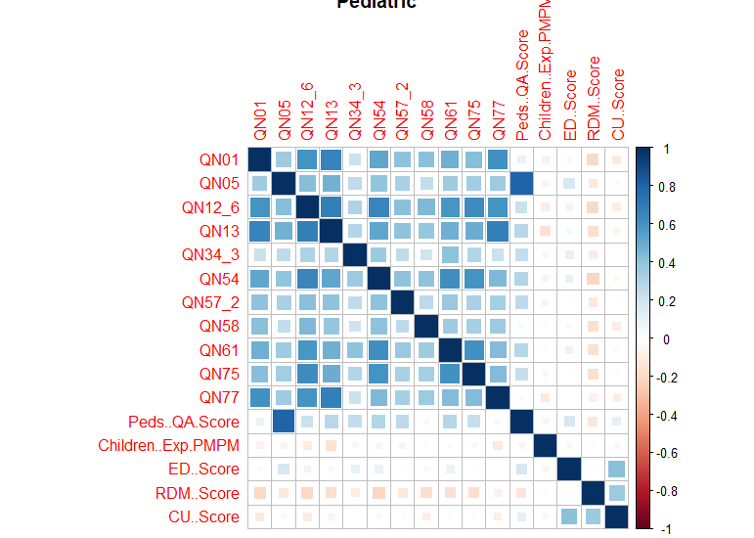
Correlation Matrices (Pediatric shown)

Slide 23
Key Insights
Most metrics had a relatively high degree of correlation
Outcomes showed no strong correlation with metrics or with each other
Except RDM and CU score, these had high positive correlation
Need to choose methods that deal with collinearity well.
Too many metrics and outcome combinations to choose an effective subset manually

Slide 24
Forward Stepwise Selection
Further Refinement of Regression Models (Adult Population Shown, selected with BIC criteria)
QA | PMPM | ED | RDM | CU
QN02.4 | QN08 | QN02.3 | QN41 | QN35
QN09 | QN41 | QN02.4 | QN45 | QN44
QN35 | QN46 | QN78 |  | QN45
QN44 | QN60 |  |  | QN77
QN55 | QN78
QN64
QN69
QN77
QN78

Slide 25
Key Insights
Adult Pop.: Selection usually cut 2-3 significant variables
7 cut from ED score
Senior Pop.: Usually cut between 0-2
Tended to have a lower number of significant metrics
Pediatric Pop.: Same as seniors

Slide 26
LASSO Regression
PMPM | QA | ED | RDM
QN08 | QN02.3 | QN78 | QN41
QN09 | QN02.4 |  | QN45
QN40 | QN35
QN41 | QN41
QN78 | QN44
 | QN9
 | QN55
 | QN64
 | QN69
 | QN71.2
 | QN78

Slide 27
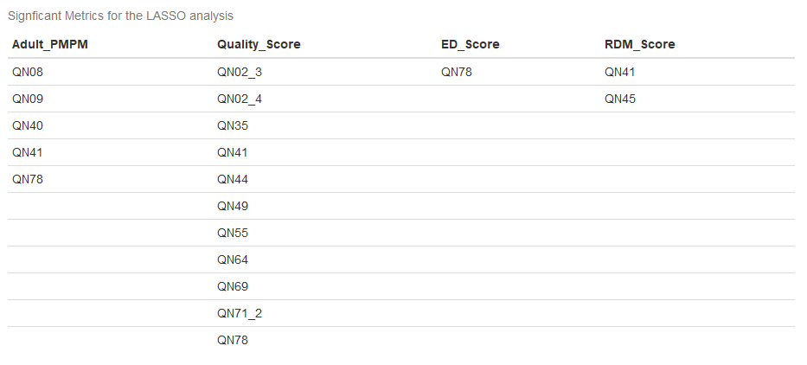
LASSO Regression (other chart if this looks better)

Slide 28
Key Insights
Represents our best approximation of significant metrics
Generally agreed with our other regressions
ED only had 1 significant metric
Pediatric PMPM had none
In general, ED, RDM, and CU always had less metric associated compared to PMPM

Slide 29
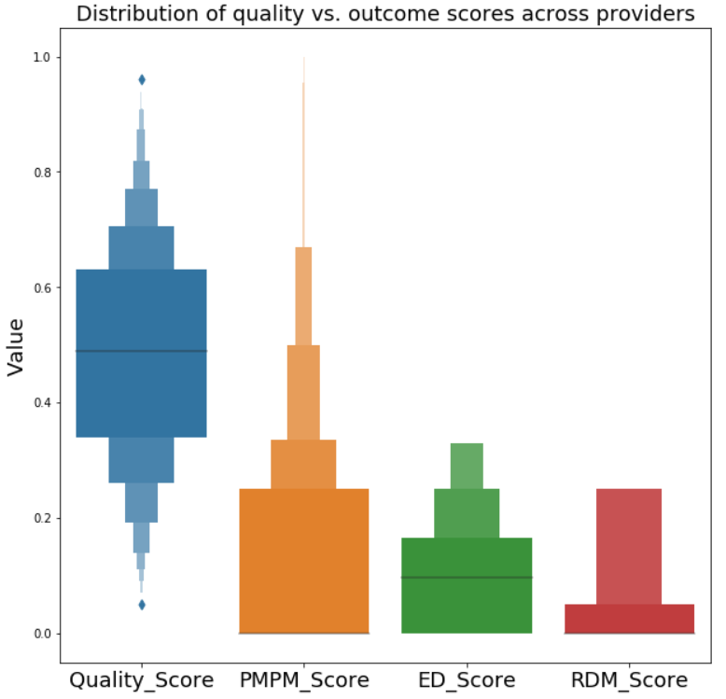
Quality and Outcomes

Slide 30
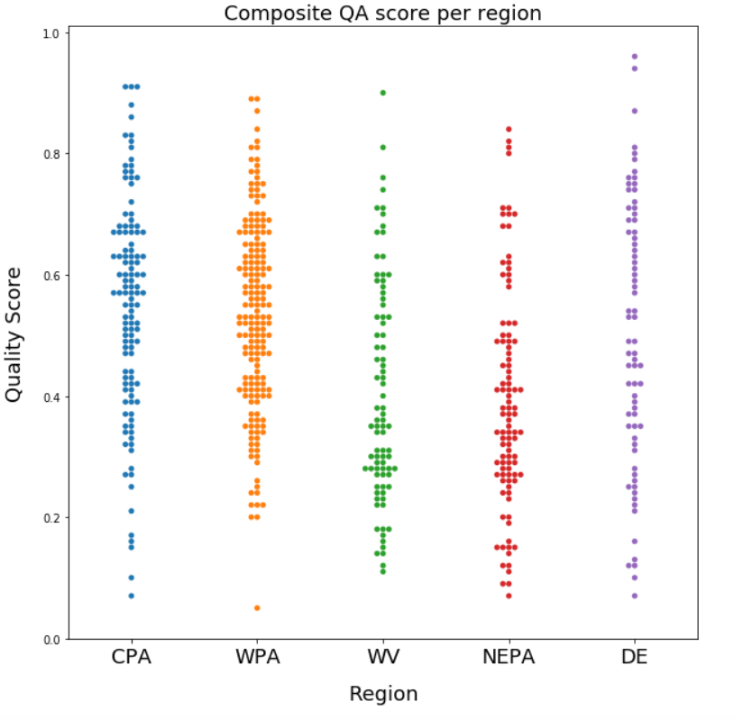
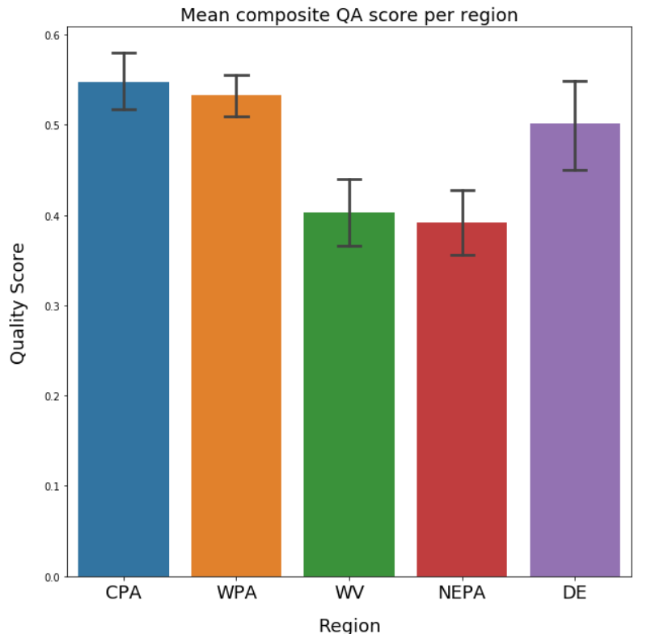
QA Score per Region

Slide 31
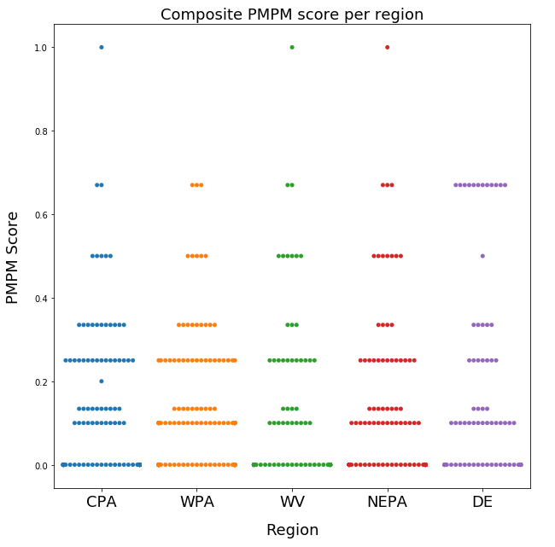
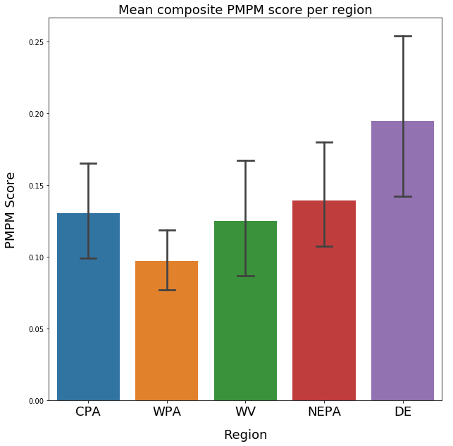
PMPM Score per Region

Slide 32
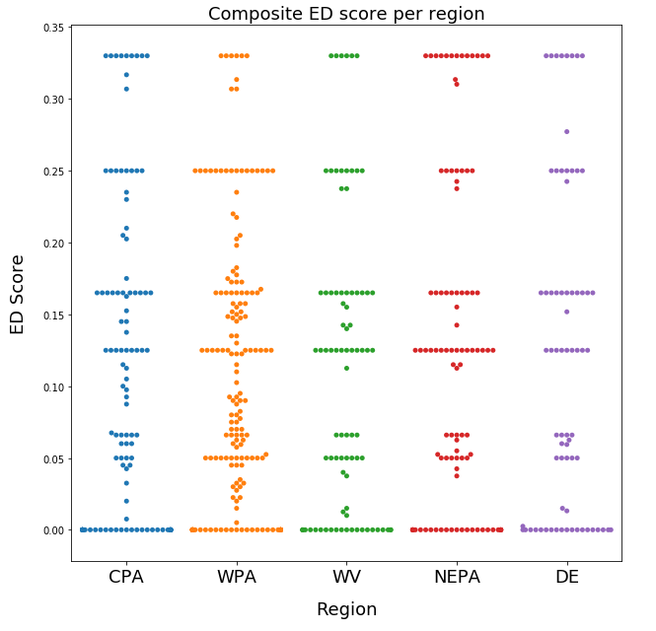
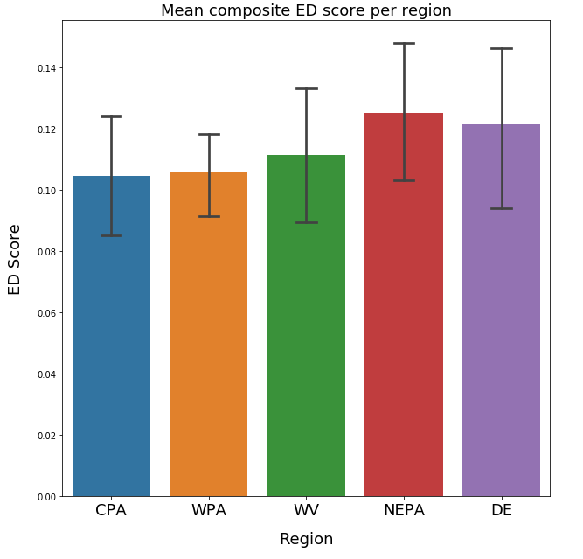
ED Score per Region

Slide 33
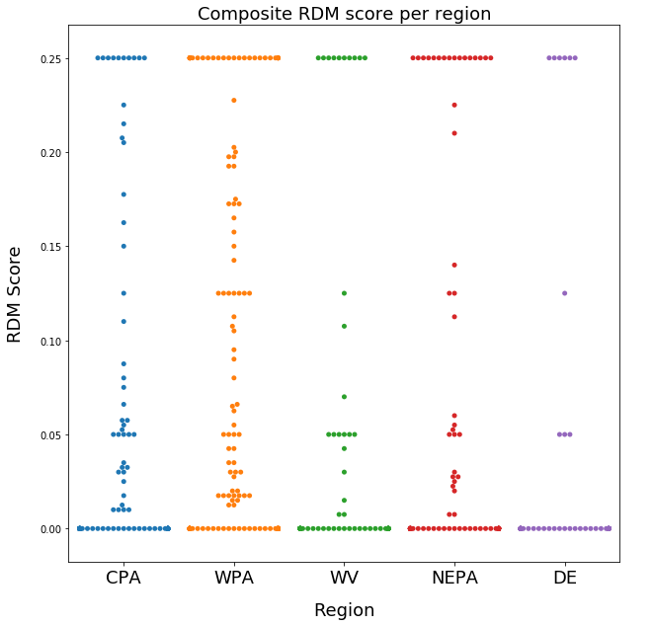
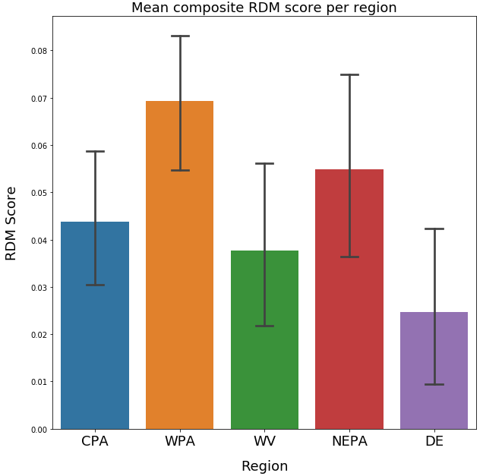
RDM Score per Region

Slide 34
Program Effects

Slide 35
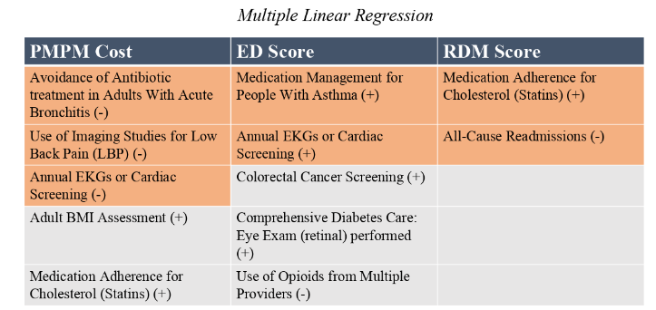

Multiple Linear Regression

Slide 36
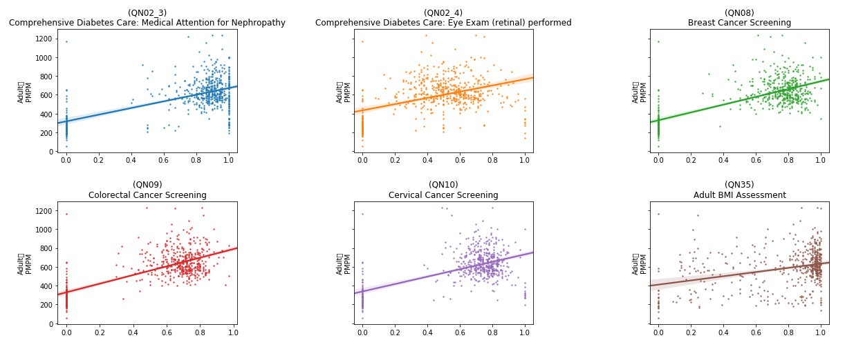
Rates vs. Adult PMPM
Adult
PMPM
Adult
PMPM
Adult
PMPM
Adult
PMPM
Adult
PMPM
Adult
PMPM
Rate
Rate
Rate

Slide 37
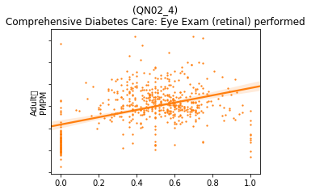
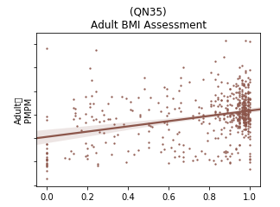
Rates vs. Adult PMPM, zoomed in
Adult
PMPM
Adult
PMPM
High variability
Low confidence

Slide 38
Findings
The analysis for the Adult population shows mixed results.
Several variables showed a high statistical correlation with the three outcomes. Some of these were expected, while a number were inversely correlated or unexplained.
Ultimately the high variance in the data and the low confidence values indicate that more collection and study should be done.
Detailed results are given in the appendix.

Slide 39
Findings v2
The analysis for the Adult population shows mixed results.
Several variables showed a high statistical correlation with the three outcomes. Some of these were expected, while a number were inversely correlated or unexplained.
Ultimately the high variance in the data and the low confidence values indicate that more collection and study should be done.
Detailed results are given in the appendix.

Slide 40
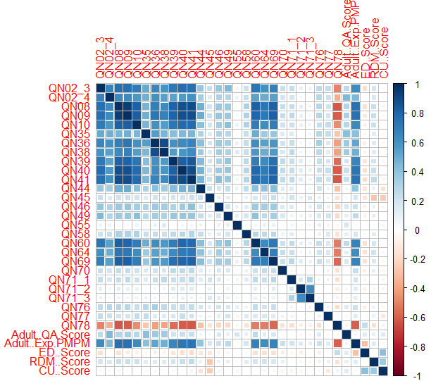
Collinearities in the data
Several variables were found to be correlated with each other
This could lead to skewed results in a standard regression test
Lasso regression and PCA can account for this problem

Slide 41
Recommendations

Slide 42
Questions?

